Slide 1
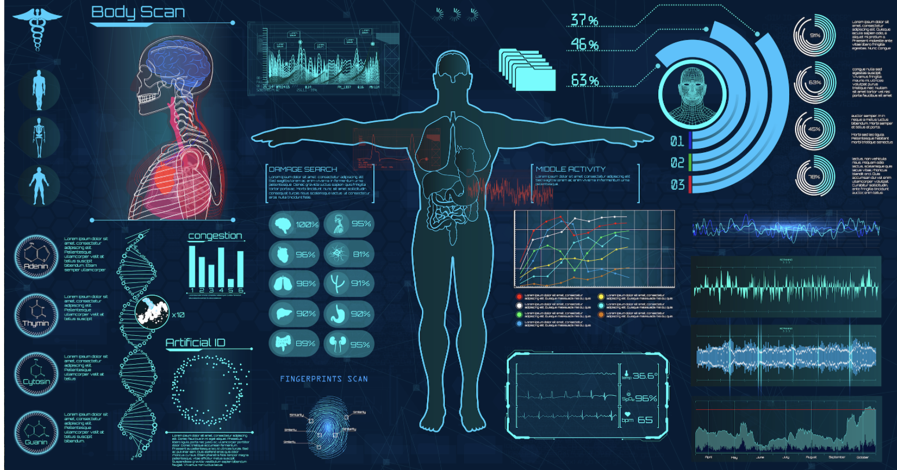
Clinical data analyst
Rahma Semma
Data 400 mini project
02/19/2024

Slide 2
Research question
What are the most frequently listed technical and soft skills in clinical data analyst job descriptions?
Understanding these skills helps job seekers, employers, and educators align with industry expectations.

Slide 3
Background
How do hospitals decide which treatments are most effective?
Data Collection
→ Processing
→ Analysis
→ Decision-Making
Clinical data analysts collect, process, and analyze clinical data from trials, patient records, and research studies.
Their work ensures data accuracy and provides insights that support healthcare decisions and improve patient outcomes.
Requires proficiency in statistical tools, data visualization, and knowledge of healthcare systems and regulations.

Slide 4
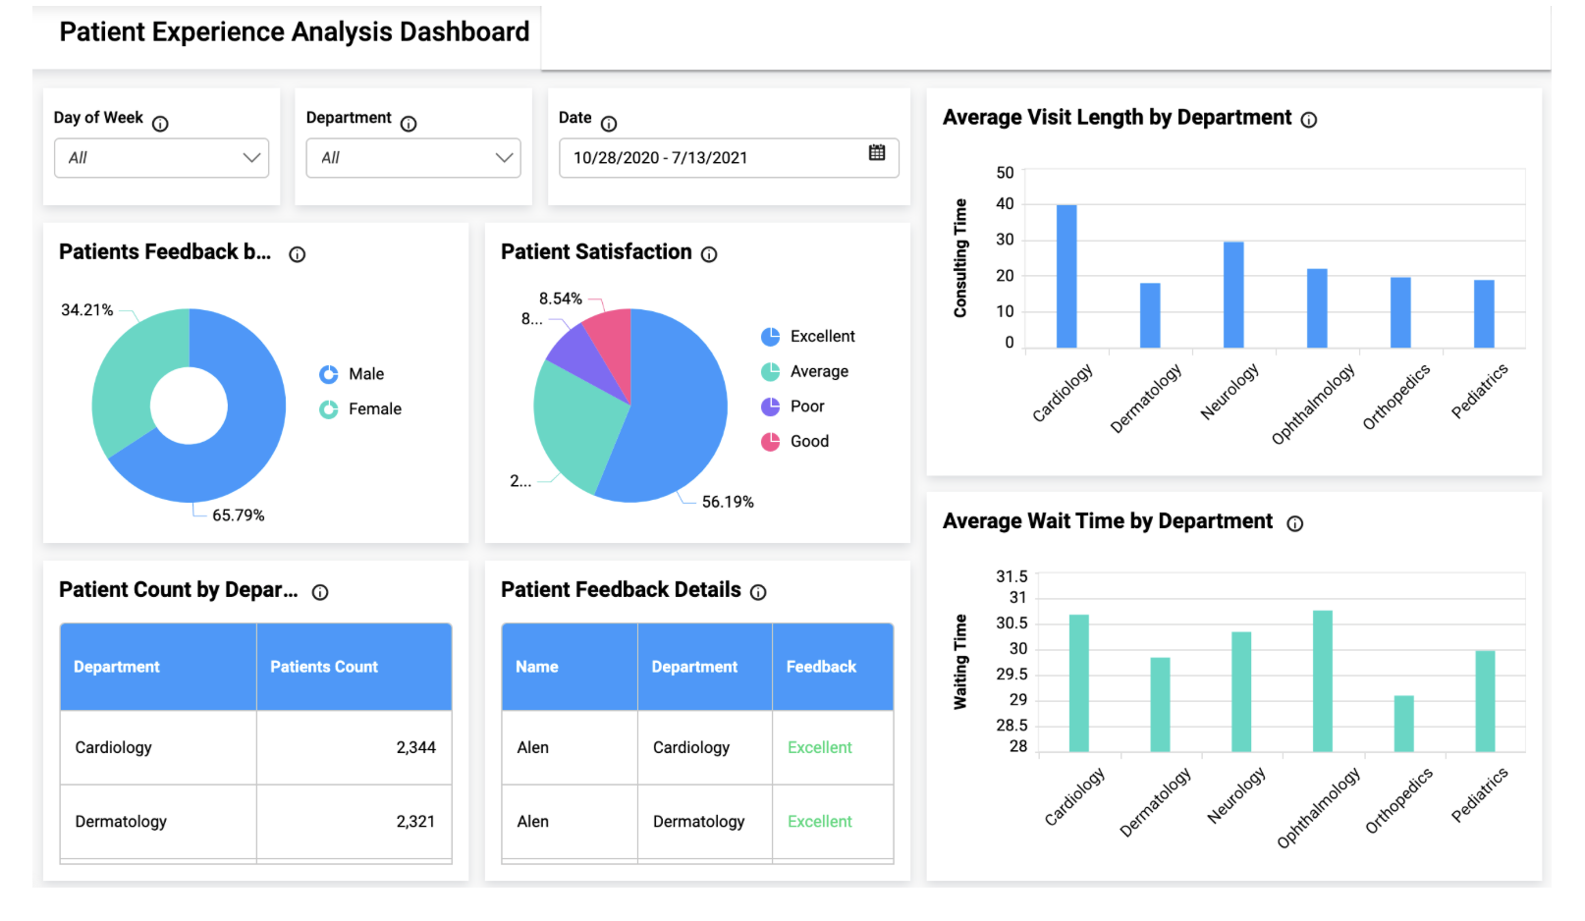
Example of Clinical Data Analysis
In this dashboard, we see different types of data visualizations:
A breakdown of patient feedback by gender and satisfaction level.
Average wait times and visit lengths by department.
A summary of patient counts per department.
Clinical data analysts transform raw patient data into meaningful insights. This dashboard represents how data can be used to assess patient feedback, wait times, and satisfaction, supporting better healthcare decisions.

Slide 5
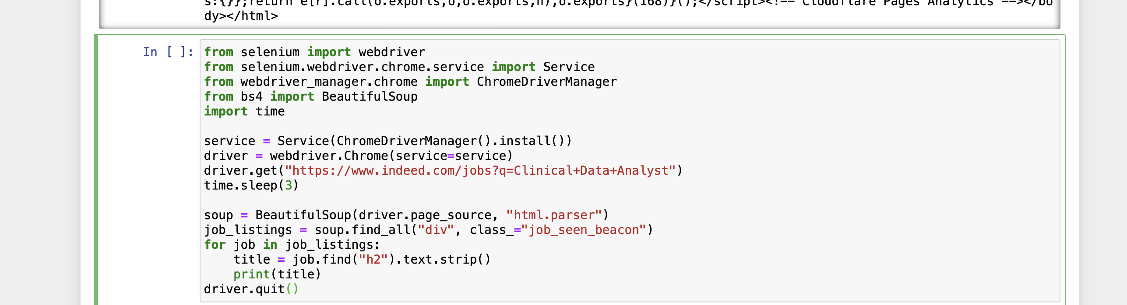
Data Retrieval - Web Scraping Approach Tools Used: Selenium & BeautifulSoup for job description extraction.
Challenges Faced:
Indeed blocks automated scraping; encountered CAPTCHA.
Resolved using rotating user agents & delays.

Slide 6
Alternative Approach - API vs Web Scraping
Why Not Use an API?
Indeed and LinkedIn restrict job data APIs.
Web scraping allows us to extract real-time job descriptions.
Comparison of Methods
Method | Pros | Cons
Web Scraping | Custom data extraction | Can be blocked
API (if available) | Structured & reliable | Limited access

Slide 7
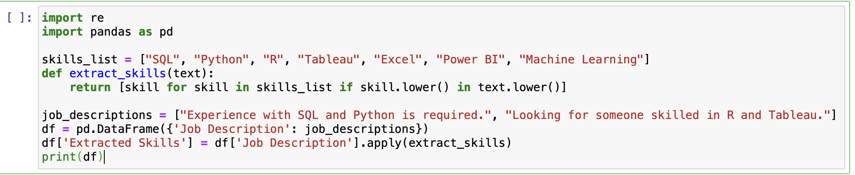
Data Processing & Cleaning
📌 Common Cleaning Steps: ✅ Removing HTML tags and special characters. ✅ Standardizing text (lowercasing, removing extra spaces). ✅ Filtering out stopwords (e.g., ‘the’, ‘and’, ‘with’). ✅ Extracting only relevant skill-related keywords.
Extracting Skills from Job Descriptions:
Regex-based filtering helps identify specific skills.
Predefined skill lists allow automated classification.
DataFrame storage makes it easier to analyze trends later.
Expected Output vs Actual Findings:
Expected: SQL, Python, R, Tableau.
Actual: Found additional keywords like "data modeling" and "ETL" indicating advanced skills.

Slide 8
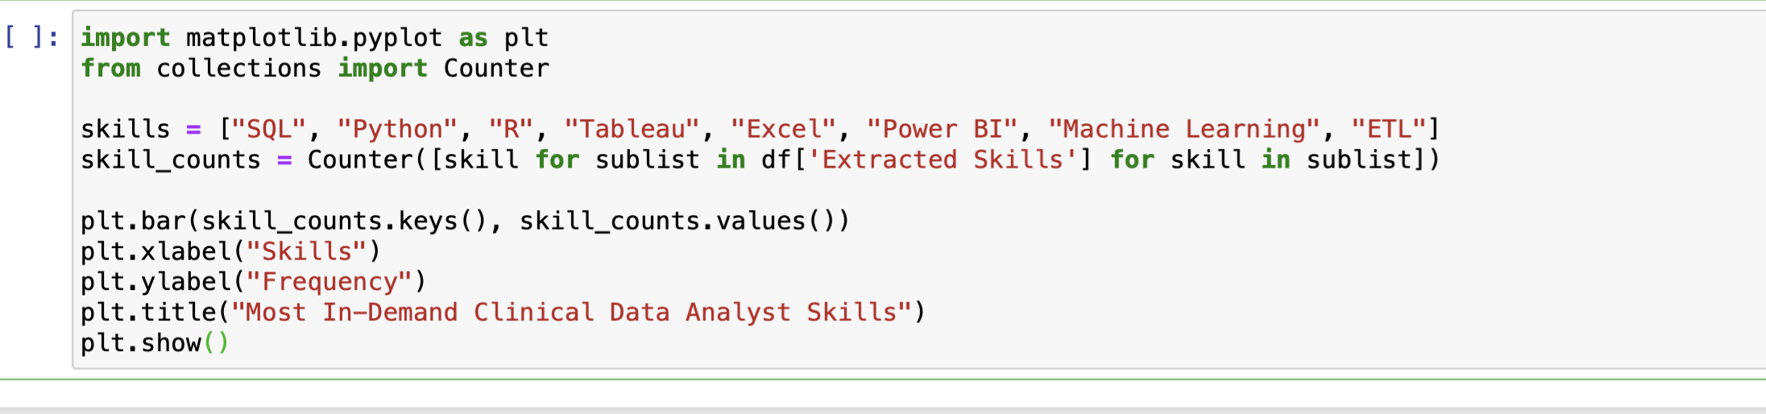
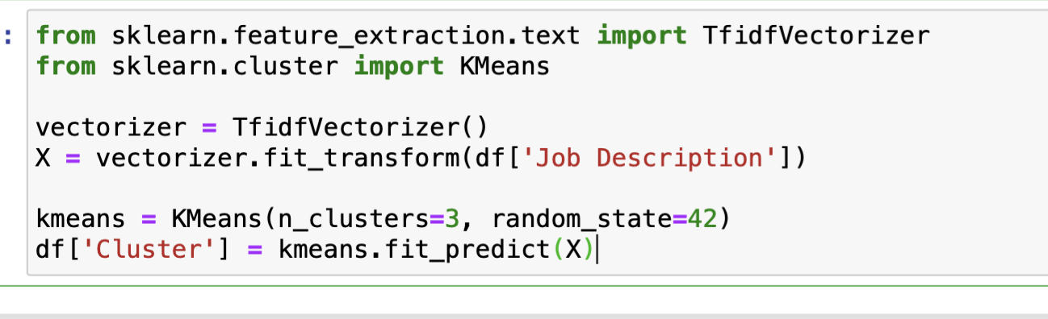
Exploratory Data Analysis & Clustering
Visualizing Skill Frequencies:
Clustering Job Descriptions:
Approach: Used TF-IDF vectorization + K-Means clustering.
Findings:
Cluster 1: Hospital-based roles (focus on EHR, regulatory compliance).
Cluster 2: Pharma-related roles (strong on statistical modeling, R, SAS).
Cluster 3: Tech roles (data engineering, cloud computing, SQL, Python).

Slide 9
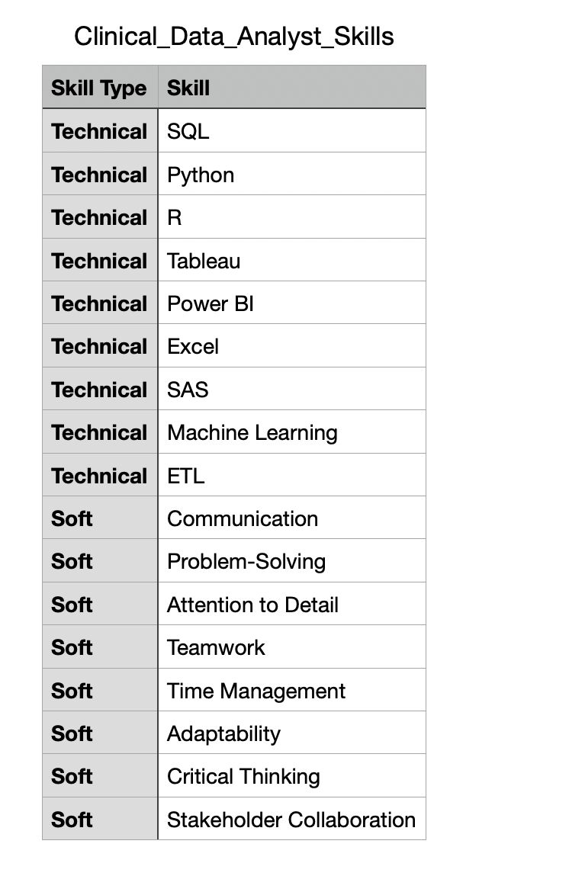
Tractable Data

Slide 10
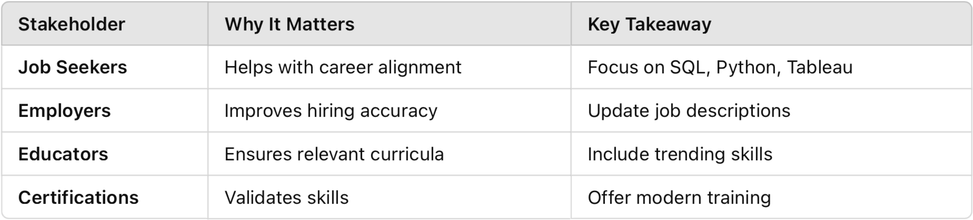
Implications for Stakeholders
Job Seekers:
Optimize resumes based on skill demand.
Improve technical skillset with SQL, Python, visualization tools.
Employers:
Align job descriptions with actual industry needs.
As a hiring manager, scraping job postings from your competitors lets you see their salary ranges.
You can use this to ensure your compensation packages remain attractive.
As a job seeker, web scraping job postings reveal that Python, Excel, SQL, and Tableau are the top three most in-demand skills for data analysts.
Tailor your resume and skill development accordingly.
Educators:
Revise curriculums to emphasize trending skills.

Slide 11
Ethical, Legal, and Societal Considerations
Ethical Issues
Avoiding biased job selection; focusing on diverse postings.
Legal Concerns
Compliance with web scraping laws & site policies.
Societal Impact
Bridging the gap between academic training & industry demand.

Slide 12
Conclusion & Next Steps
Summary of Findings:
SQL, Python, and Tableau dominate skill requirements.
Soft skills like communication & teamwork are essential.
Clustering shows distinct industry preferences.
Future Work:
Expanding dataset to include multiple years.
Applying NLP to refine skill extraction.

